Slide 1
Protein Threading Based on Multiple Protein Structure Alignment
Tatsuya Akutsu Kim Lan Sim
Human Genome Center, Institute of Medical Science, University of Tokyo
4-6-1 Shirokanedai, Minato-ku, Tokyo 108-8639, Japan
Presenter: Chung-Han Chiang
Date: Dec, 14, 2006

Slide 2
Abstract
Protein threading, a method employed in protein three-dimensional (3D) structure prediction was only proposed in the early 1990's although predicting protein 3D structure from its given amino acid sequence has been around since 1970's. Here we describe a protein threading method/system that we have developed based on multiple protein structure alignment. In order to compute multiple structure alignments, we developed a similar structure search program on massive parallel computers and a program for constructing a multiple structure alignment from pairwise structure
alignments, where the latter is based on the center star method for sequence alignment. A simple dynamic-programming based algorithm which uses a prole matrix obtained from the result of multiple structure alignment was also developed to compute a threading (i.e., an alignment between a target sequence and a known structure). Using this system, we participated in the threading category (category AL) of CASP3 (Third Community Wide Experiment on the Critical Assessment of Techniques for Protein Structure Prediction). The results are discussed.

Slide 3
Introduction
Most methods are based on the assumption that amino acid sequence determines the 3D structure.
Methods:
Protein threading
input – amino acid sequence. compare – a set of protein structures. ( structural patterns )
score function
Fold
Protein Threading: the process of computing an alignment between a sequence and a structure.

Slide 4
Choose the possible candidates
Search the similar structure to each candidates
Multiple structure alignment is computed from pairwise structure alignment
Protein threading

Slide 5
Similar structure search on parallel computer
Stralign: a program for computing a structure alignment between two protein structures. But it take too long time if stralign were directly applied to similar structure search.
Solution: a parallel program which executes several tens of stralign processes on a massive parallel computer.

Slide 6
Master-slave model
Master process watches the status of all slave processes.
Slave idle.
Master process sends a protein structure which is not yet compared, to the idle slave.
The slave process computes a structure alignment (using stralign) between that structure and the input structure, and return the result

Slide 7
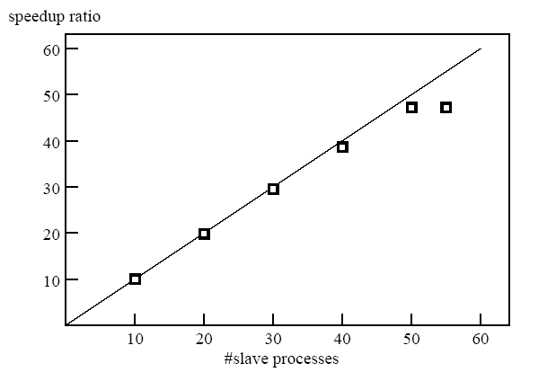
The speedup ratio against the number of slave process

Slide 8
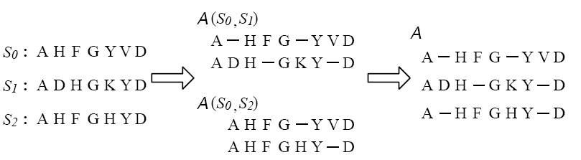
Multiple Structure Alignment from Pairwise Structure Alignments
The center star method:
The center star method for multiple sequence/structure alignment.
S₀ is the center in this example.

Slide 9
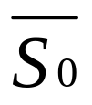
A(S_{0,} S_{i}) denotes the structure alignment between S₀ and S_{i}.
I₀ be the maximum number of gap symbols placed before the first character (residue) of S₀ in any of the alignments A(S_{0,}S₁); … ; A(S_{0,}S_{n}); I_{|S0|} be the maximum number of gap symbols placed after the last character (residue) of S₀ in any alignments. And I_{i} be the maximum number of gaps placed between character S_{0,i} and S_{0,i+1}, where S_{j,i} denotes the i-th letter of string Sj
inserting I₀ gaps before S₀, I_{|S0|} gaps after S₀, and I_{i} gaps between S₀,_{i}and S₀,_{i+1}.

Slide 10

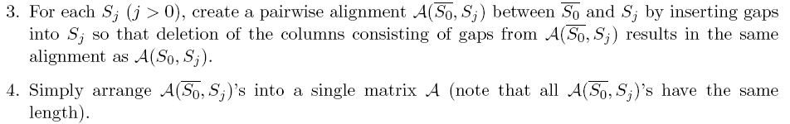
:

Slide 11


Protein Threading Based on Multiple Structure Alignment
Let X = x₁…x_{n} be an input amino acid sequence (i.e., X is a string over alphabet such that | |= 20), which is a target sequence for 3D structure prediction.
A threading T between X and A is obtained by inserting gap symbols (denoted by '−') into or at either end of X and A such that the resulting sequences are of the same length l, where columns of A must be preserved.
An optimal threading is computed in the following way. Let ci be the i-th column of A. Let c¹_{1…}c^{N+1}_{i} be amino acids in column ci. Then, we define the score between x_{j} and c_{i} by
where s(x, y) is a usual score function for sequence alignment

Slide 12
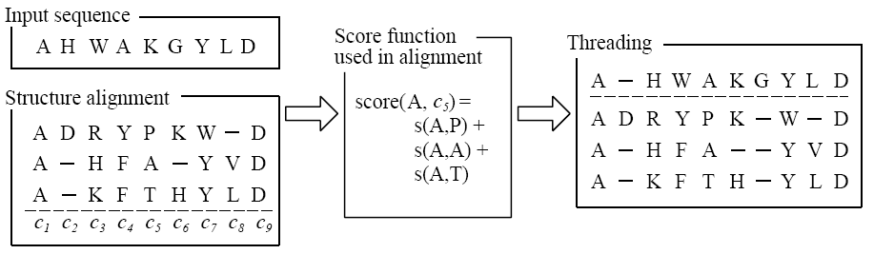

Slide 13

Although we implemented and examined the above algorithm, its performance was not good because the number of proteins having strong structural similarities but having weak sequence similarities was small.
Assume that the user convince that part of an input sequence x_{i}…x_{i+k} must corresponds to part of a structure alignment c_{j}…c_{j+k} from additional information such as PHD results. Then, we can put this constraint by letting the score function as follows:

Slide 14
